Slide 1


Slide 2

INTRODUCTION
Bookstore management system mainly focuses on the activities of a book store such as information on books and books sold to customers. The database flexibility, convenient features, the maximum increase in customer service, access to accurate information make this ideal for all sizes of book stores.

Slide 3
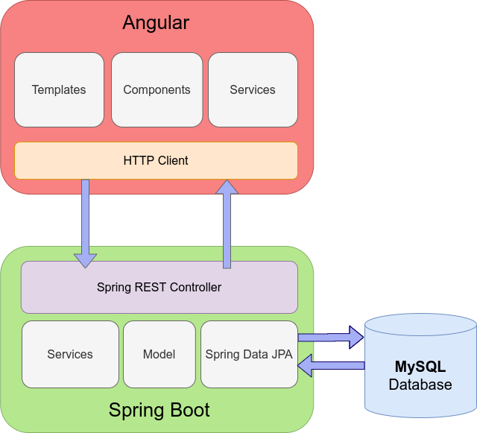

Slide 4
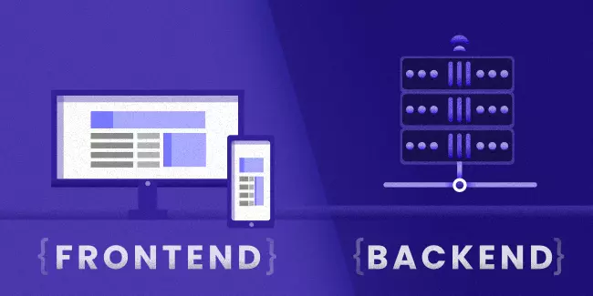

Slide 5


Slide 6
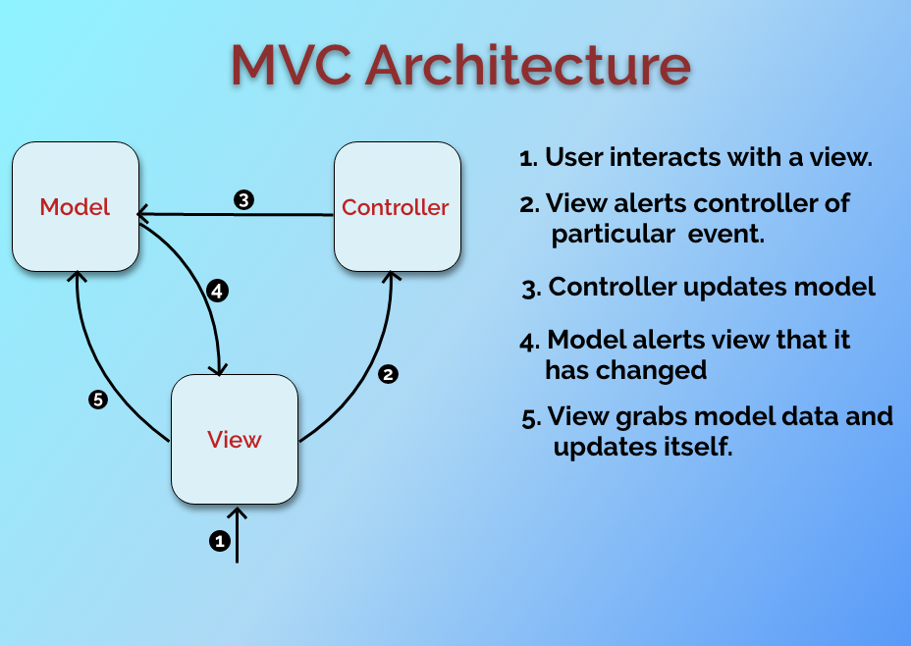

Slide 7
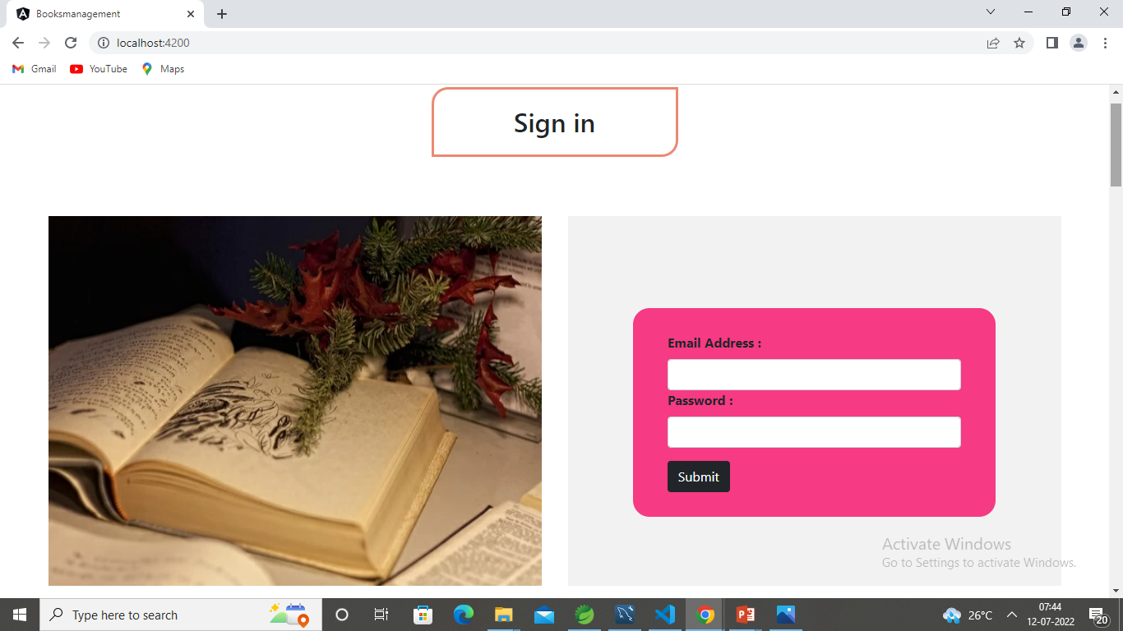

Slide 8
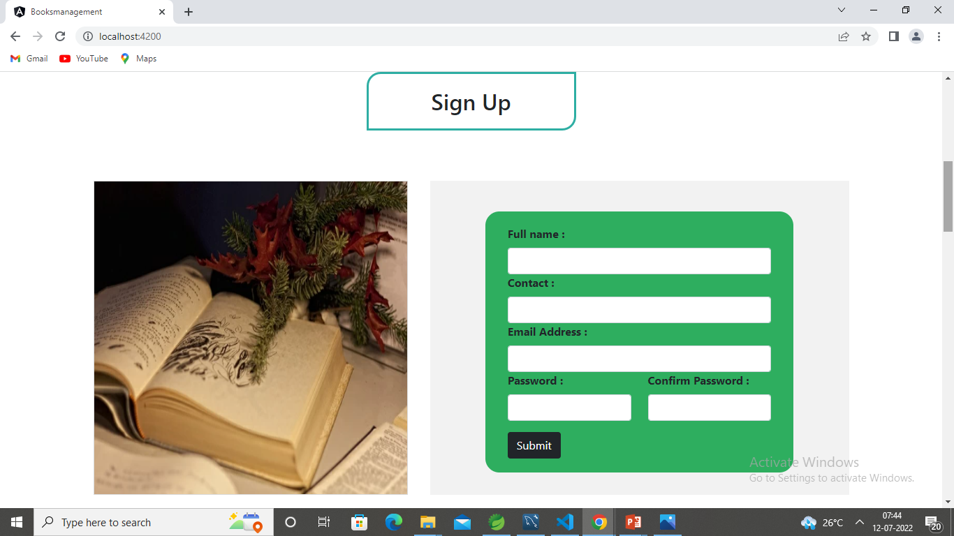

Slide 9
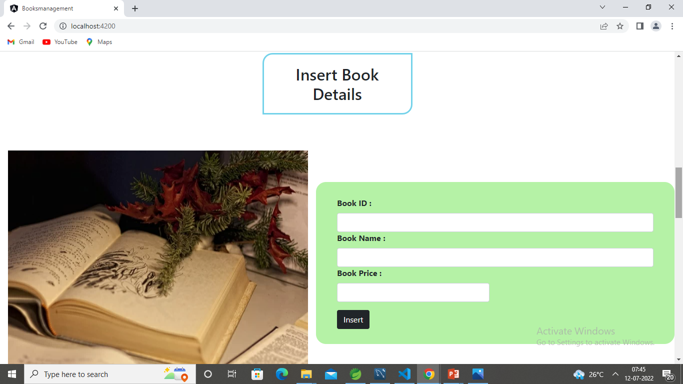

Slide 10
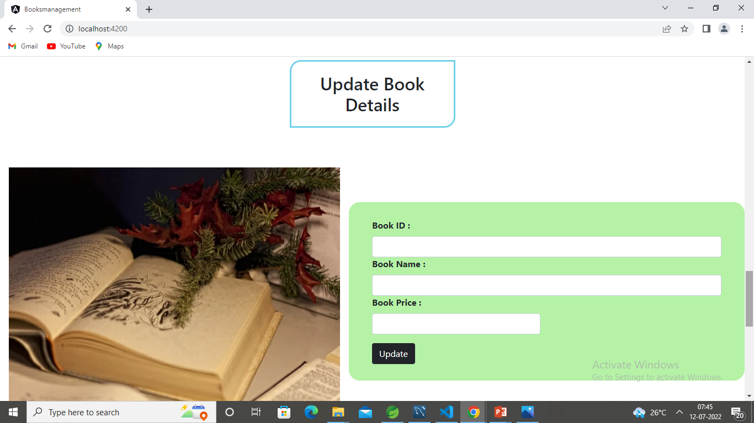

Slide 11
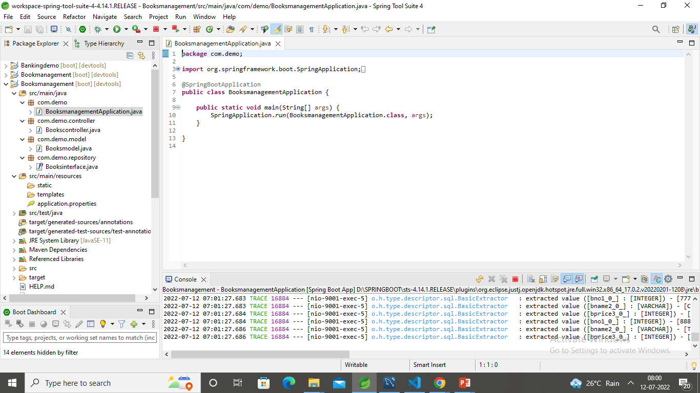
Spring Boot Application

Slide 12
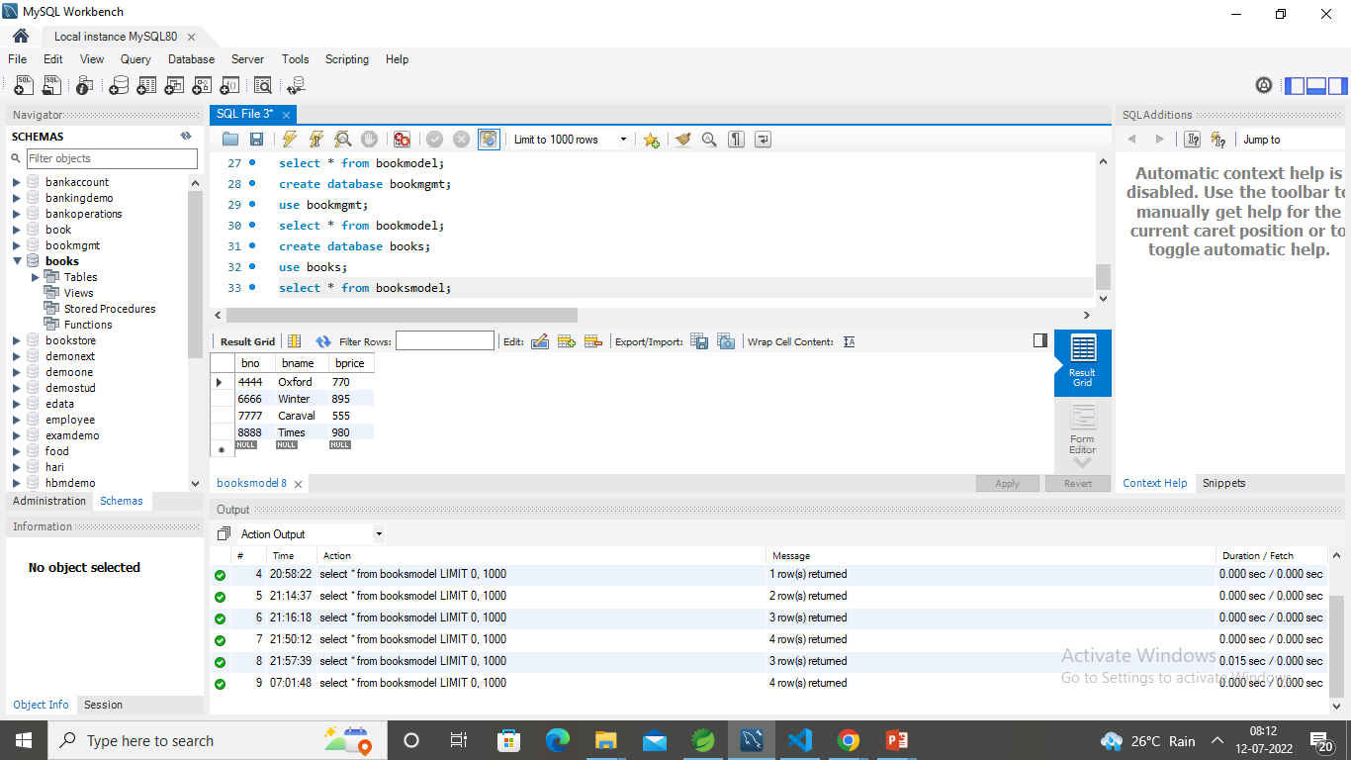
MySQL Database

Slide 13
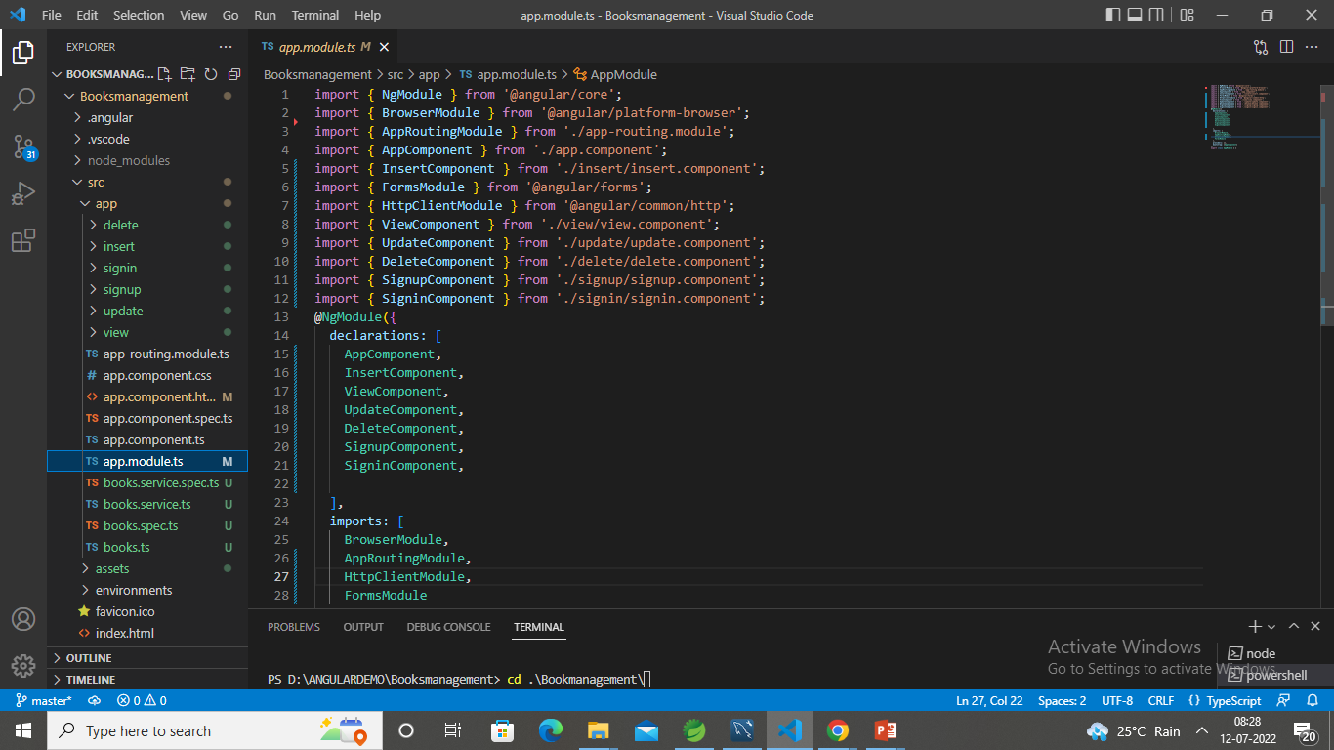
Angular JS

Slide 14
Future scope
This Software can be easily implemented under various situations.
Any institute can make use of it for providing information about author and content of available in their bookstore.
Modifications can be easily done according to requirements and when necessary.
It can be used by any types of book stores for managing sales and purchasing activities and managing data records.

Slide 15
Thank you

Slide 16
Github Link:
https://github.com/Harish-Kutty/BookRepo.git

